Slide 1
Lecture 3: Optic array and the direct perception of slant
Optic array
Slant perception

Slide 2
The ecological approach to perception (Gibson)
$$Environment ≡Information ≡Perceived environment$$
Perception -- to gain direct awareness of behaviorally relevant properties (Perception-Action coupling)
Successfully action is the criterion for veridical perception
Empirically, measuring the effectiveness of perception using actions (not, say, verbal accounts)
Cannot separate an actor from her environment (Actor-Environment mutuality)
Information is key
Can’t perceive, if there is no information
do not use inference to ”fill in the blank”; if no info, you simply don’t perceive
Information is found in the optic array (reanalyze S_{P} as optic array)

Slide 3
Environment and econiches
Environment: the physical world and its properties relevant to animals and their behaviors
Echoniche: a partitioning of environmental properties that are relevant to a particular species’ way of life
A-E mutuality: animal and econiche co-evolved
Animal → adaptation; econiche → niche construction
Animals are adapted to regularities of their niche that support successful perception/action
Physical regularities: habitat, food sources, surface properties…
Informational regularities: patterns of stimulation that specify behaviorally-relevant properties of niche

Slide 4
How does a narwhal perceive surface penetrability?
Sensory organ: the tusk
What does it perceive?
Penetrability of ice (an environmental property in its econiche)
Information for perception: change of salt concentration
The perceptual process: The tusk detects salt concentration changes to perceive penetrability of surface ice

Slide 5
Computational vs. Ecological Approach to Perception
What do we see?
Constructivist/computational: proximal stimuli (retinal images, neural impulses etc)
Eco approach: physical world
How do we see?
Eco approach: Info from structured light → perception
Direct perception, from structured light as info to perception
The eyes pick up and the brain measures info
Computational approach: distal stimuli→ proximal stimuli → sensation → perception
Perception is indirect and mediated by sensation
The eyes detect stimuli, the brain constructs/computes representations

Slide 6
Ecological optics

Slide 7
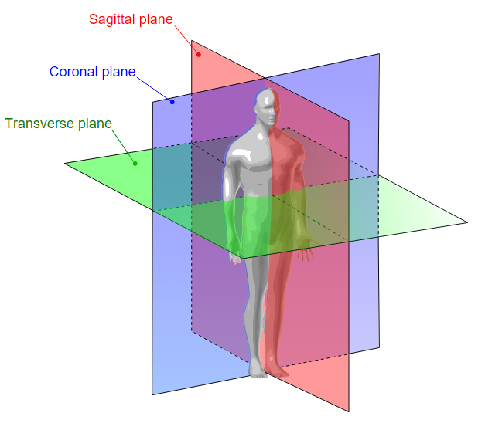
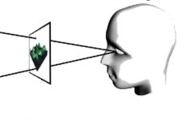
Coordinates and references of the optical space
Frontoparallel plane
= Coronal plane
size
depth
width/length
height
Frontoparallel plane

Slide 8
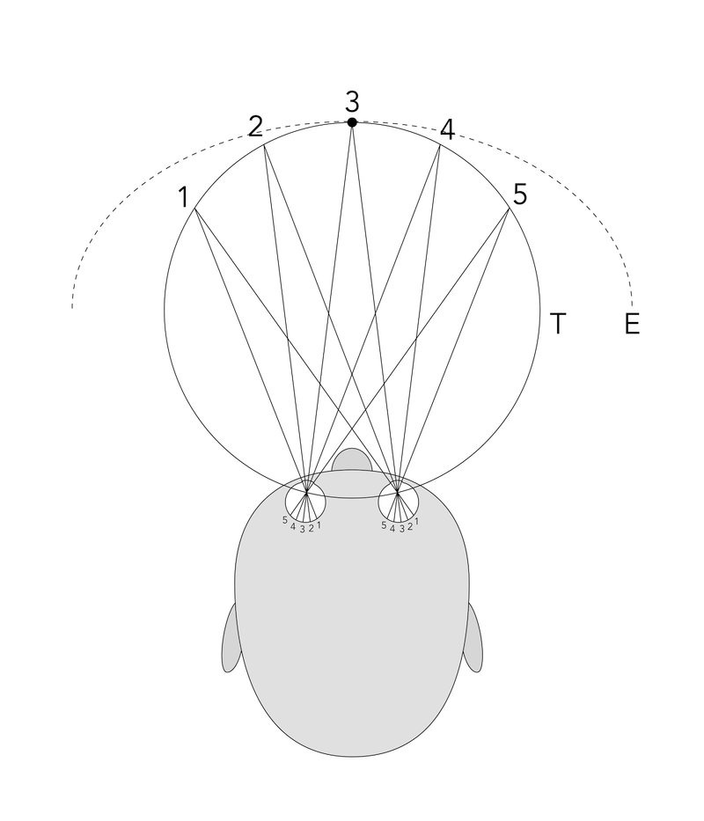
The frontoparallel plane cannot be flat or the points on it will have different depths
The geometry of the visual space is spherical, not Euclidean
But, we often make assumptions… sometimes we assume that the frontoparallel plane is flat and Euclidean
When is it O.K. to assume so?
horopters
Notes:
In studies of binocular vision the horopter is the locus of points in space have the same disparity as fixation. This can be defined theoretically as the points in space which project on corresponding points in the two retinas, that is, on anatomically identical points. The horopter can be measured empirically in which it is defined using some criterion.

Slide 9
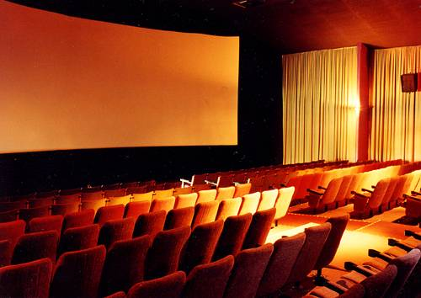
Curved mega screen brings a better visual experience

Slide 10

In visual perception, measures should be angular (instead of linear), and the visual space is no Euclidean but Spherical.

Slide 11
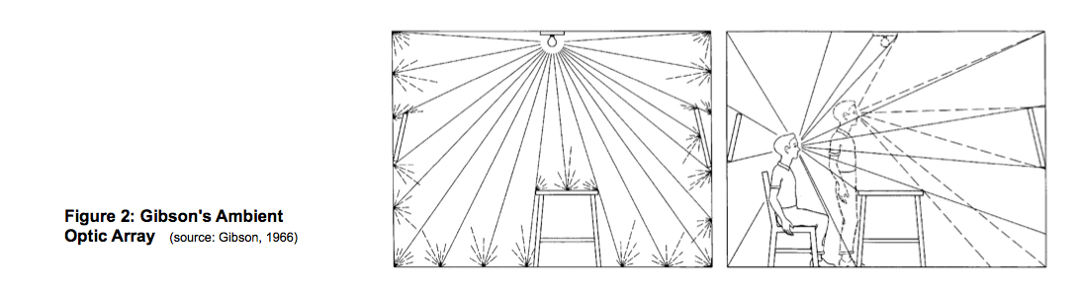
Radiant vs. ambient light
In the real world,
Radiant light = light from the source (light as energy)
Homogeneous, unstructured, uninformative.
Ambient light = light reflected by the opaque surfaces in the world
Heterogeneous, structured (by surrounding world objects), contains info.

Slide 12
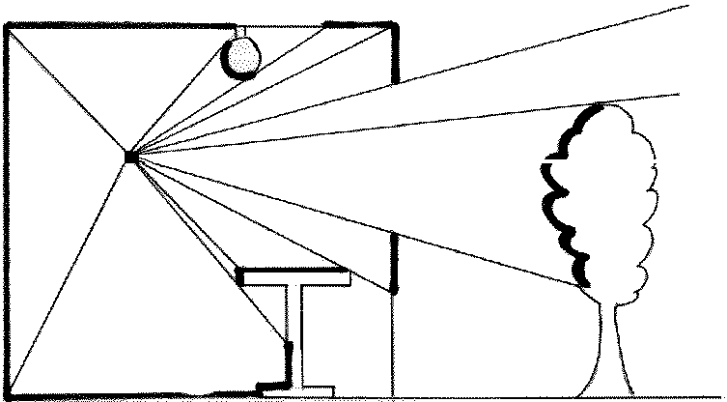
Optic array
The optic array is a nested array of visual solid angles (VSA’s) that are formed by the ambient light converging on the point of observation (POO).
All measures in the optics are angular.
Point of Obs
Notes:
Picking up contrasts, forming angles.

Slide 13
Optical structures are not copies (or similar to) world structures that project them
What do you think you will see? Why?
Gibson (1979/1986) pg 154--155
Notes:
Can you explain why this happens?
Texture gradient

Slide 14
Surfaces
Substance, medium and surfaces → surfaces separate medium from substance; they are one-sided
E.g. The skin (surface) separates an observer (substance) from the medium of light
Surface or plane?

Slide 15
Surfaces
Substance, medium and surfaces → surfaces separate medium from substance; they are one-sided
E.g. The skin (surface) separates an observer (substance) from the medium of light
“Substantial surfaces”: opaque (reflects light), contains layout, subject to laws of physics (gravity, elasticity etc)
Surface vs. plane
The perceptible surface layout :
Textures
Orientations(e.g. slant)

Slide 16
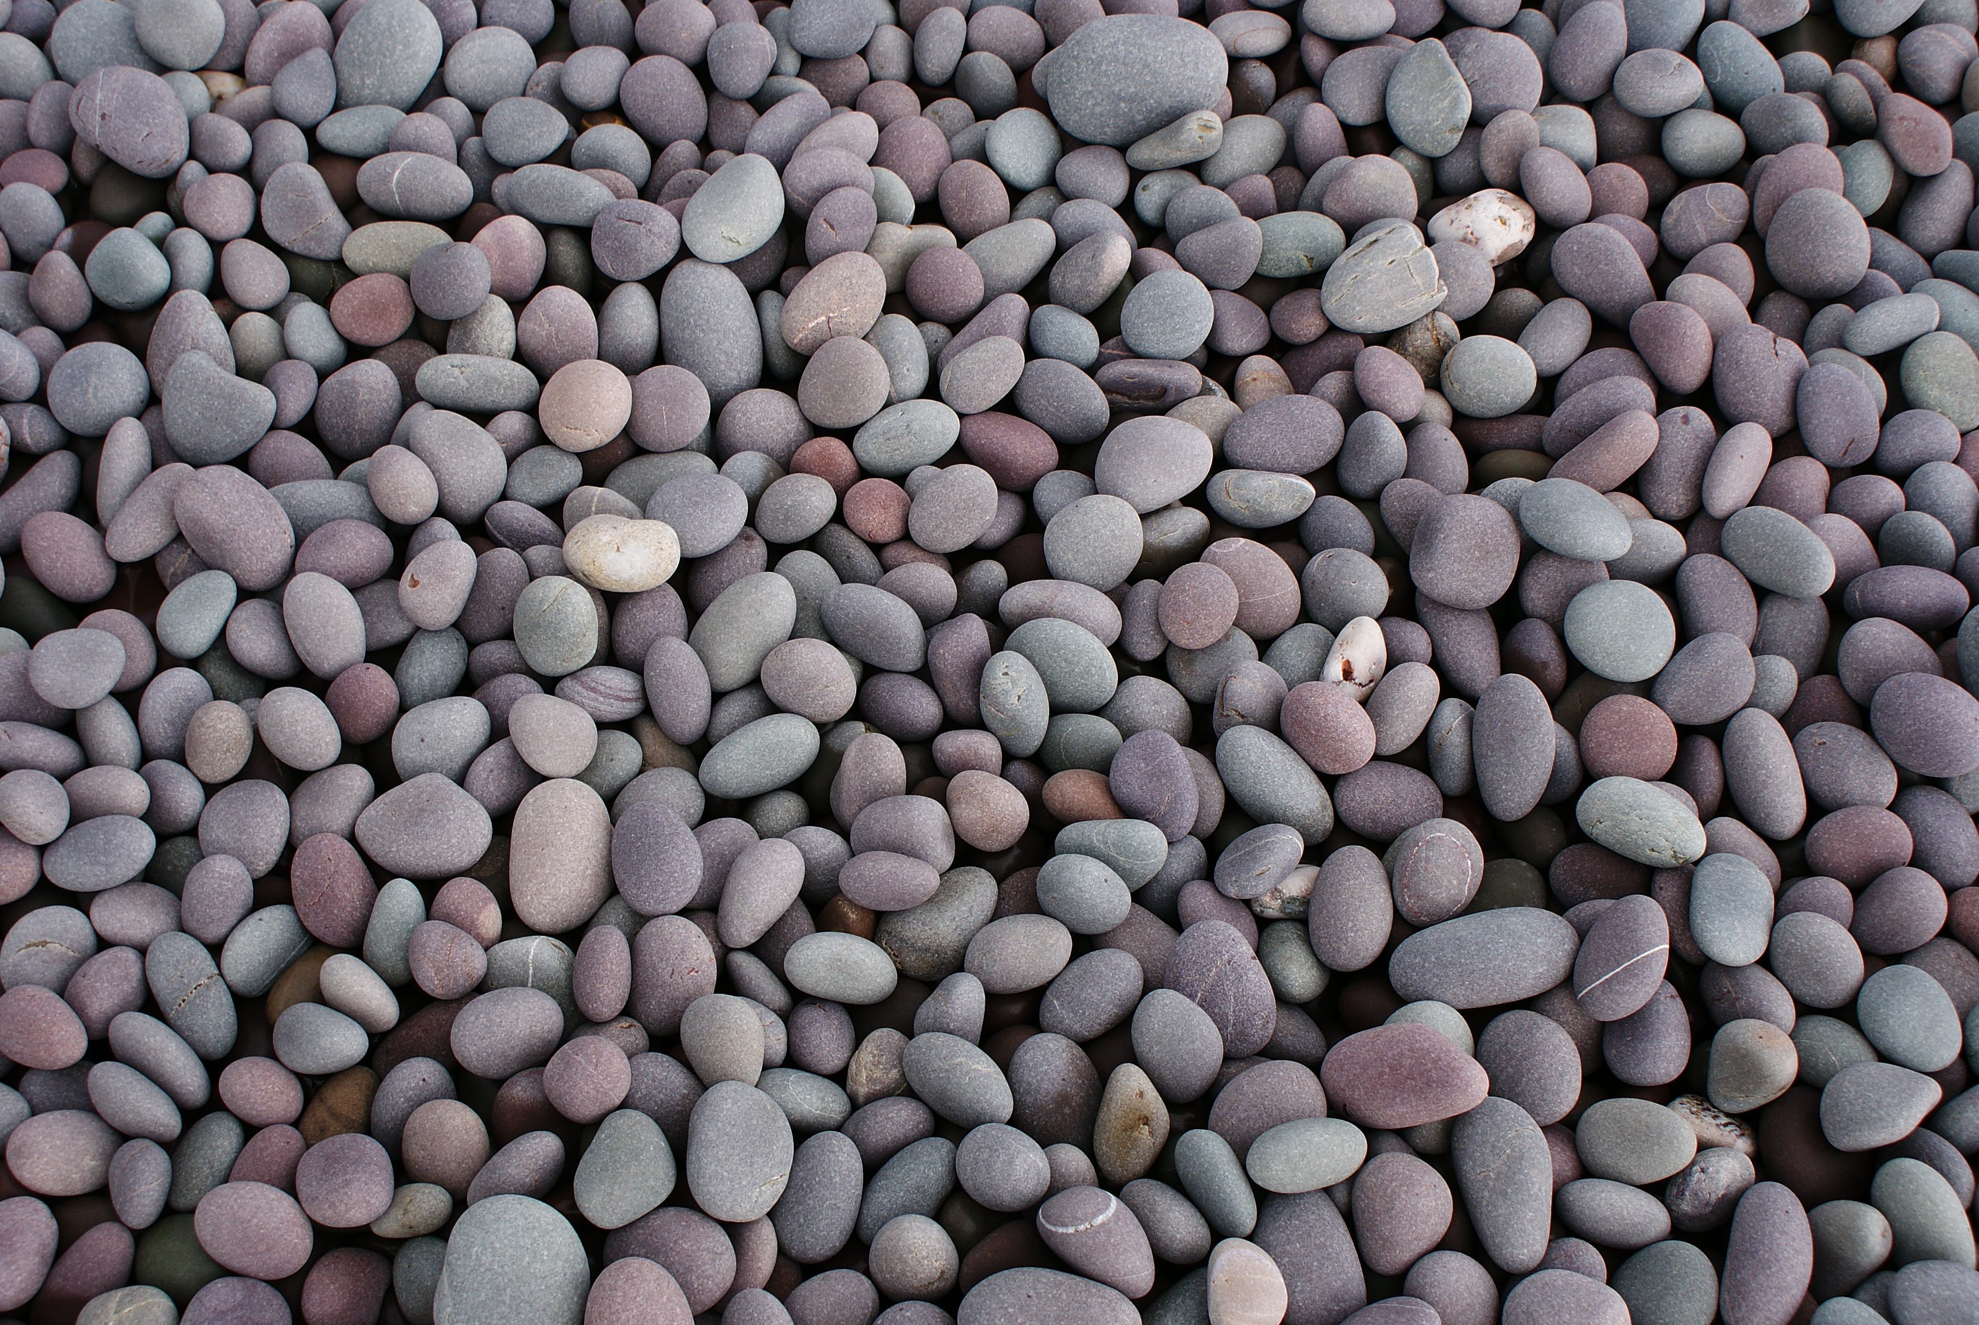
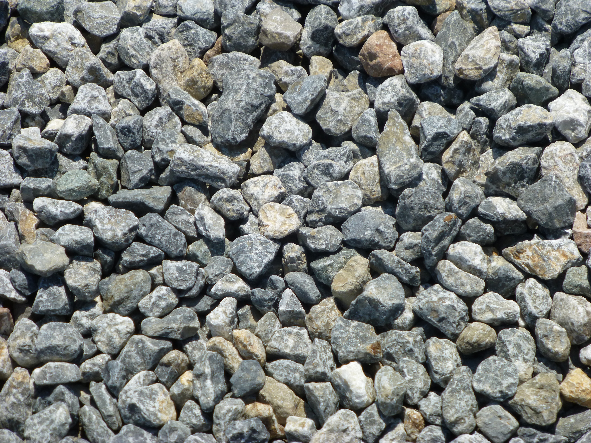
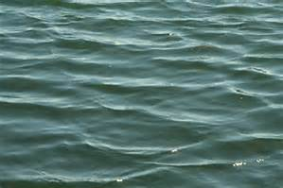
Surface textures are perceptible by detecting light patterns
Notes:
Light patterns specify surface properties… why?

Slide 17
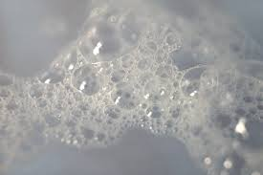
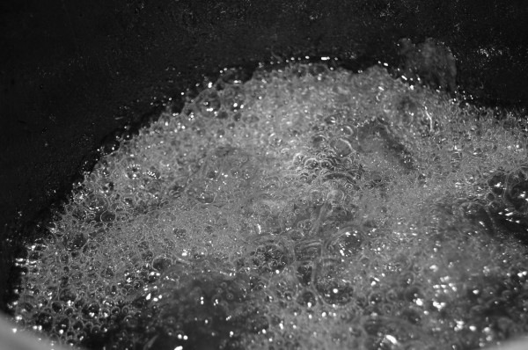
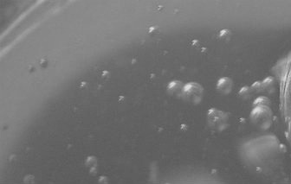
Notes:
Surface textures are perceptible. Surface properties differ because their physical properties differ (in this case, elasticity or viscousity of matters). Our perception is determined by the laws of physics

Slide 18

Surface slant is perceptible
Surface textures are perceptible

Slide 19
Perceiving Slant
What’s in the world ≠ What’s in the optics
But they are related!
Is the slant in the world or in the optics?
Is the foreshortening of texture element in the world or in the optics?
Heterogeneous texture elements enables perception

Slide 20
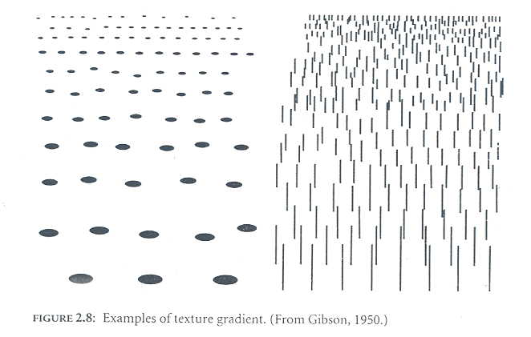
Foreshortening in the optics
Foreshortening: an object or distance to appear shorter than it actually is because it is angled toward the viewer. An object is often not scaled evenly: a circle often appears as an ellipse and a square can appear as a trapezoid, when slanted.

Slide 21
Textures on the ground

Slide 22
Optic Array: Higher-order spatiotemporal patterns of stimulation that are specific to environmental properties within an ecological context of constraint (means constraints from the environment)
Textured ground

Slide 23


Perceiving Slant
Gradient: rate of change of texture elements
Notes:
For stochastic textures

Slide 24
Perceiving Slant
Gradient: rate of change of texture elements

Slide 25
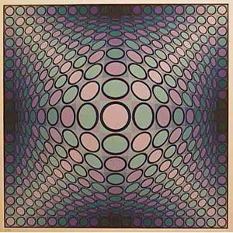
Perceiving Slant
Gradient: rate of change of texture elements

Slide 26
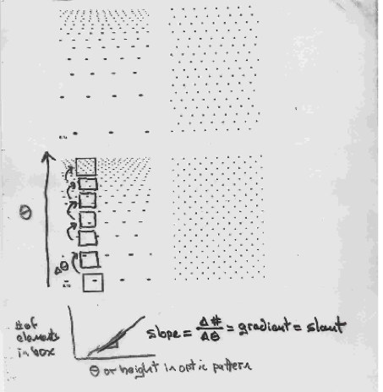
Gradient = rate of change of size, density, and foreshortening of texture elements.
Rate of change = info about local slant
Notes:
texture elements Gradient, its rate of change… these are all in the optics. In the world, real pebbles has not change.

Slide 27
Sudden change in density w/o changing gradient indicate no change of slant, seen as a “step”.
Sudden change in gradient indicates a change in slant, seen as a “bent”.
Small gradient
Equal
gradient;
Diff density
Large gradient
Optical patterns specify world properties (not similarity based)

Slide 28
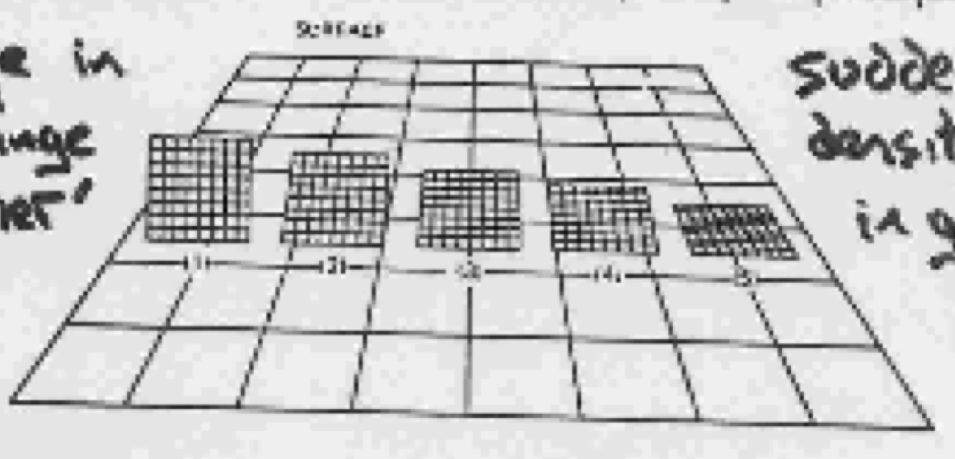

Slide 29
Terms we covered in this class
Perception and Action
Optics, world
Surface (vs. plane)
Texture element
Slant
Foreshortening
Texture gradient
What is the optical information for slant?

Slide 30
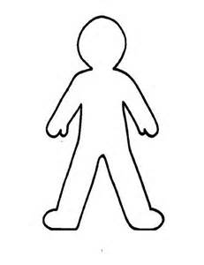
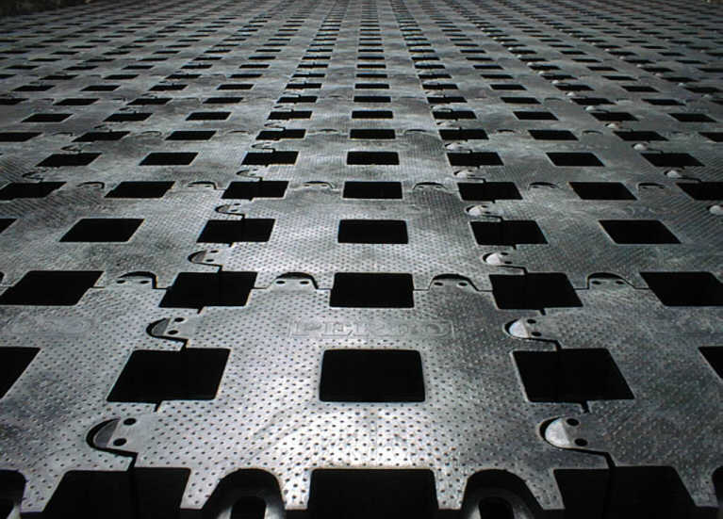
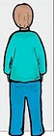
If I stand here and experience foreshortening, what about my friend who is standing across the field from me? What does this suggest in an eco framework?

Slide 31
Reading
Chapters 2 and 3 of Gibson (1979/1986).

